Slide 1
iOPS for Salalah (SLL) airport

Slide 2


6 CRITAL ALARMS
AVG Hook-up
3:45
-
63°F
85% RH
10:30AM
2/29 SUN
-
-
-
SCREEN
Login
This time must come from central clock.
User Name
Password
Reset User Name / Password
Auto Logout if not active for 15 min
User Level's: 1.) Normal Operator (Viewing Only) 2.) Maintenance (Viewing and reset service counters and service alarms) Level 3. Maintenance (Calibration and Configuration of Adjustable Parameters) Level 4 Administrator (Viewing and Controlling)

Slide 3
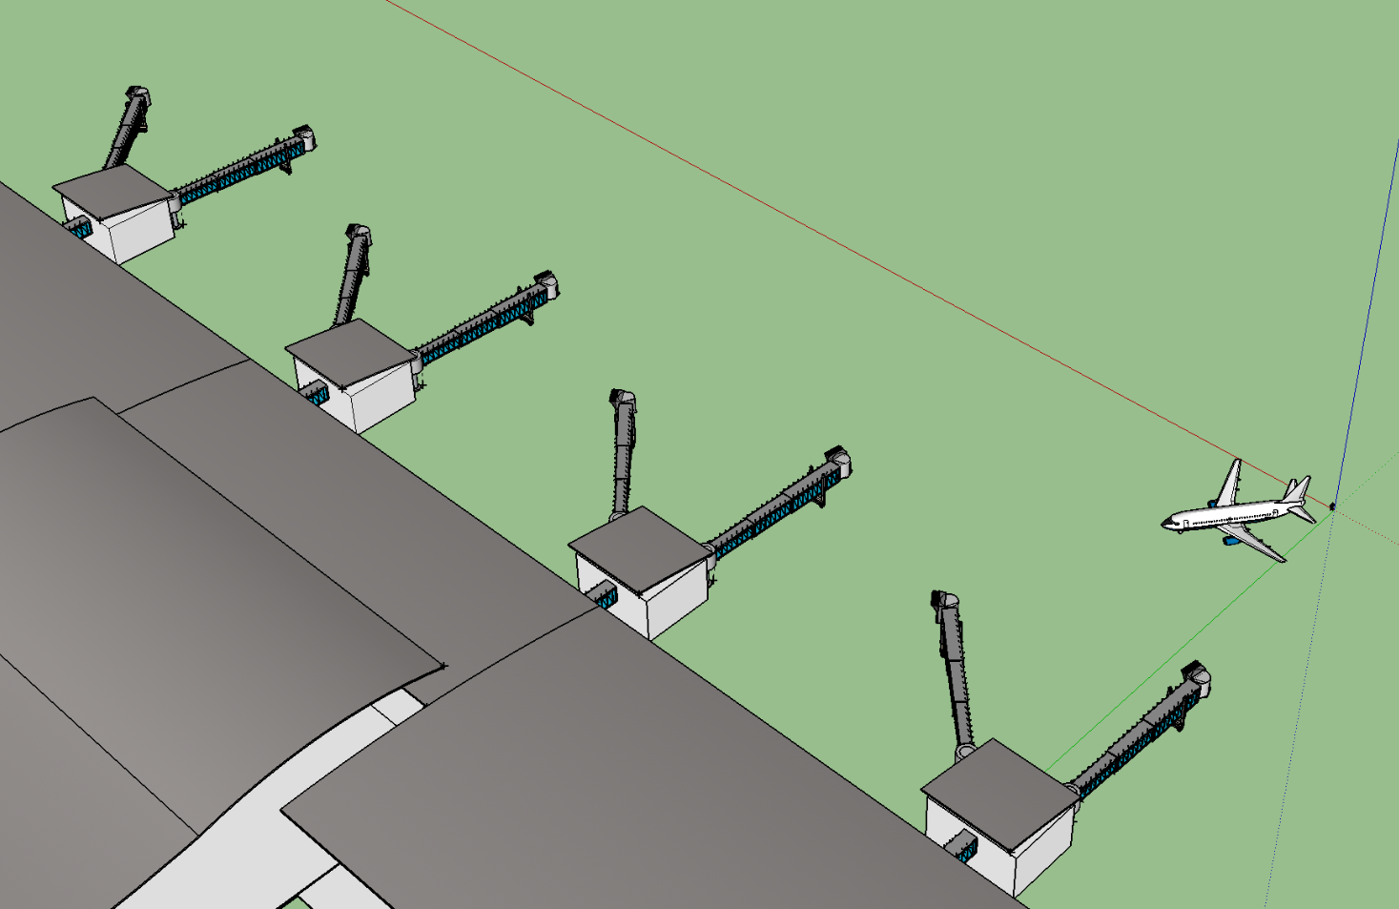
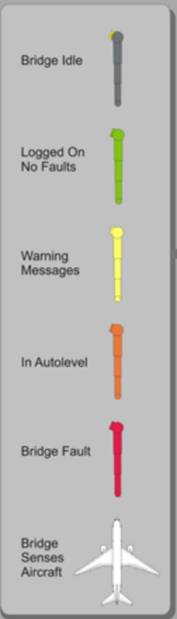
6 CRITAL ALARMS
AVG Hook-up
3:45
-
63°F
85% RH
10:30AM
2/29 SUN
-
-
-
SCREEN
Salalah
31F
Need to Replace Image
31B
29F
29B
25F
25B
23F
23B
Not Ready = Error
Ready = No Alarms and has Power
Manual Operation = Bridge in Operate Mode.
Semi-Automatic Mode = Auto Level On
Error = Any Fault
Fire Alarm

Slide 4
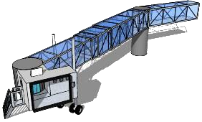
6 CRITAL ALARMS
AVG Hook-up
3:45
-
63°F
85% RH
10:30AM
2/29 SUN
-
-
-
SCREEN
Gate 1
Gate 3
Gate 2
Gate 4

Slide 5
6 CRITAL ALARMS
AVG Hook-up
3:45
-
63°F
85% RH
10:30AM
2/29 SUN
-
-
-
SCREEN
Gate 1
Point
Remote Bridge Control
Operation Mode
E-Stop
AutoLevel
AutoLevel (Backup)
Canopy
Vertical Movement
… Up / Down / Limit
… Position | 15’ 5”/4.1 M
… Upper Limit | 28’ 5”/8 M
… Lower Limit | 8’ 5”/2.7M
Horizontal Movement
… Position (X/Y) | 15 / 54
… Speed | 1.2 MPH
Tunnel Length (Feet / Metters) | 118 Ft / ?? M
Front Shutter / Doors
Sensor/Photo Cell
Encoders | 2341256
PBB CCTV
Roof Top AC Units
Activated
Disabled
Note: When In AutoLevel Show AC at Gate
Semi-Auto
Not Ready
Ready
Man-Op
Ready / OK
Activated
Ready / OK
AutoLevel
Alarm
Ready / OK
Alarm
Note: Show AC at Gate when in Semi-Auto Mode
Ready / OK
Extended
Retracted
Ready / OK
Not Ready
Off
Move-Up
Move-Dn
Up - Limit
Low - Limit
Point
Power To Bridge
UPS Power Supply
Bridge Lighting
Emergency Lighting Power
Fire Alarm System
VDGS Interlock
PCA Pit
400hz Pit
Aircraft Type: | 747-400
Aircraft Position: | ??????
Dock Time | 14:35
Un-Dock Time | 16:50
ON
Alarm
Note: Remote Control (On / Off)
Off
ON
Forward
Backwards
Ready / OK
Not Ready
Off
Alarm
Off
ON
Closed
Open
Ready / OK
Open
Closed
Open
Clear
Occupied
Note: Remote Control (On / Off)
Operational
Alarm
Ready / OK
On

Slide 6
6 CRITAL ALARMS
AVG Hook-up
3:45
-
63°F
85% RH
10:30AM
2/29 SUN
-
-
-
SCREEN
Gate 1 (Service Counters)
Point | Count | Reset Date
E-Stop (Count) | 345 | 06/01/14
AutoLevel (Count) | 345 | 06/01/14
AutoLevel (Backup) (Count) | 345 | 06/01/14
Canopy (Count) | 345 | 06/01/14
Vertical Movement (Count) | 345 | 06/01/14
Horizontal Movement (Count) | 345 | 06/01/14
Front Shutter / Doors (Count) | 345 | 06/01/14
Sensor/Photo Cell (Count) | 345 | 06/01/14
Roof Top AC Units (Count) | 345 | 06/01/14
Power To Bridge (Count) | 345 | 06/01/14
UPS Power Supply (Count) | 345 | 06/01/14
Bridge Lighting (Count) | 345 | 06/01/14
Fire Alarm System (Count) | 345 | 06/01/14
VDGS Interlock (Count) | 345 | 06/01/14
PCA Pit (Count) | 345 | 06/01/14
400hz Pit (Count) | 345 | 06/01/14
Reset All
Reset
Reset
Reset
Reset
Reset
Note: Show AC at Gate when in Semi-Auto Mode
Reset
Reset
Reset
Reset
Reset
Reset
Reset
Reset
Reset
Reset
Remote Enable and Disable
Reset
Activated
Disabled

Slide 7
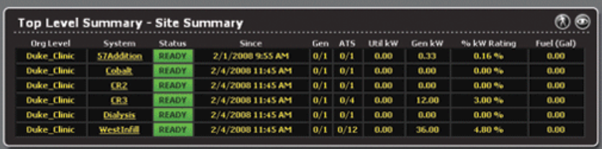
6 CRITAL ALARMS
AVG Hook-up
3:45
-
63°F
85% RH
10:30AM
2/29 SUN
-
-
-
SCREEN
Active Alarms Page
Page for Alarms and Alarm Summary's: All alarms shall have alarm counters that are resettable for the operator. All Alarms shall be saved for a minimum of one year. Alarms shall be divided into separated groups. It Shall be possible to acknowledge an alarm in the alarm list and jump directly to the page containing the part triggering the alarm

Slide 8
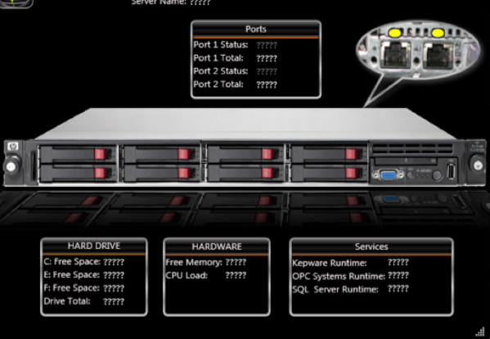
6 CRITAL ALARMS
AVG Hook-up
3:45
-
63°F
85% RH
10:30AM
2/29 SUN
-
-
-
SCREEN
Network Monitoring
Server A
Server B
SCADA Redundancy (Switch from one scada to the other from the HMI and to be able to see which one is active.

Slide 9
6 CRITAL ALARMS
AVG Hook-up
3:45
-
63°F
85% RH
10:30AM
2/29 SUN
-
-
-
SCREEN
Flight Data-Inbound
Flight Data-Outbound
SCADA Shall Display (Aircraft Type and Model, Aircraft Position, Docking time, Undocking Time, Information from the 400hz Power Supply System Regarding Pits / Hatches, On Block and Off Block)

Slide 10
6 CRITAL ALARMS
AVG Hook-up
3:45
-
63°F
85% RH
10:30AM
2/29 SUN
-
-
-
SCREEN
Today
Flight Data-Inbound
Flight Data-Outbound
Drop-Down to select Today, yesterday, last week, last month. Year, year to day. Install Date to To-Day
Charts:
Gate utilization
Alarms by group
Alarms by gate
Number of cycles
Hours of operation
Current status
Top 4 alarms by group
Average gate turn times
Same for 400hz along with
Output voltage high and low
400hz high Avg

Slide 11
6 CRITAL ALARMS
AVG Hook-up
3:45
-
63°F
85% RH
10:30AM
2/29 SUN
-
-
-
SCREEN
Today
Reports
Gate
Start Date/Time
End Date/Time
Point 1
Point 2
Point 3
Point 4
Aircraft
Aircraft Type
Drop-Down to select Value, Just put data Into Grid with a way to export to Excel
Point Type

Slide 12
General Instructions
All Starting Manoeuvers shall be confirmed. Maneuvers shall be logged by time and user
Page for Setup : The following parameters shall be able to be set as a minimum All changeable Parameters for each PBB / User Access Rights
Page for Trends shall be fully configurable in time/ Value / Number of curves and printable
Tool Tips: Tool Tips shall contain the physical name when placing the mouse over the object. It shall be possible to activate, de activate the tool tip function
Screen Resolution: 1024 x 768 and 32 bit as a minimum
Reports: It shall be fully configurable for the operator to select which information shall be in the report
Report Editing Tool shall be included
SCADA system to transfer critical alarms and status information through the AODB to the airport SCAD system. According to the project specified XML scheme. Participation in testing of the Airport Scada Interface to the Bridge
Remote Control of AC
Remote Control of Lights
Notes:
How will the VDGS - PBB Defect and Error Handling be recorded.

Slide 13
BH-04 | 23F (IN Board) | PLC | 10.174.20.1
 |  | HMI | 10.174.20.2
 |  | CCTV | 10.174.20.3
 |  | PHONE | 10.174.20.4
 |  | CARD | 10.174.20.5
BH-04 | 23B (OUT Board) | PLC | 10.174.20.6
 |  | HMI | 10.174.20.7
 |  | CCTV | 10.174.20.8
 |  | PHONE | 10.174.20.9
 |  | CARD | 10.174.20.10
BH-03 | 25F (IN Board) | PLC | 10.174.20.11
 |  | HMI | 10.174.20.12
 |  | CCTV | 10.174.20.13
 |  | PHONE | 10.174.20.14
 |  | CARD | 10.174.20.15
BH-03 | 25B (OUT Board) | PLC | 10.174.20.16
 |  | HMI | 10.174.20.17
 |  | CCTV | 10.174.20.18
 |  | PHONE | 10.174.20.19
 |  | CARD | 10.174.20.20
BH-02 | 29F (IN Board) | PLC | 10.174.20.21
 |  | HMI | 10.174.20.22
 |  | CCTV | 10.174.20.23
 |  | PHONE | 10.174.20.24
 |  | CARD | 10.174.20.25
BH-02 | 29B (OUT Board) | PLC | 10.174.20.26
 |  | HMI | 10.174.20.27
 |  | CCTV | 10.174.20.28
 |  | PHONE | 10.174.20.29
 |  | CARD | 10.174.20.30
BH-01 | 31F (IN Board) | PLC | 10.174.20.31
 |  | HMI | 10.174.20.32
 |  | CCTV | 10.174.20.33
 |  | PHONE | 10.174.20.34
 |  | CARD | 10.174.20.35
BH-01 | 31B (OUT Board) | PLC | 10.174.20.36
 |  | HMI | 10.174.20.37
 |  | CCTV | 10.174.20.38
 |  | PHONE | 10.174.20.39
 |  | CARD | 10.174.20.40
Servers |  | Server -1 | 10.174.20.41
 |  | Server -2 | 10.174.20.42
Work Stations |  | Work station -1 | 10.174.20.43
 |  | Work station -2 | 10.174.20.44
Network Configuration
SLL
PBB Server 01 (SLL_DC1_MCS_SERV01) I.P. 10.181.246.200/24 DNS (10.181.246.30/24)
PBB Server 02 (SLL_DC2_MCS_SERV02) I.P. 10.181.246.201/24 DNS (10.181.246.30/24)
PBB Workstation 01
PBB Workstation 02
MCT Phase 2
PBB Server 01 (MCT_DC2_MCS_SERV01) I.P. 10.238.246.200/24 DNS (10.238.246.30/24)
PBB Server 02 (MCT_DC2_MCS_SERV02) I.P. 10.238.246.201/24 DNS (10.238.246.31/24)
PBB Workstation 01
PBB Workstation 02

Slide 14
Arial Font
Screen background (rgb 255, 255, 246)
Menu icon (rgb 255, 216, 76)
Structure/Terminal Color (rgb 80, 80, 60) 30% transparency
Title, Gate Numbers, Highlighted Menus (rgb 43, 43, 43)
Non- Highlighted Menus (rgb 201, 201, 187)
Alert (rgb 192, 80, 77)
Graph / Box Outline color (rgb 191, 191, 191) size 0.25 pt
Second header bar/box header (rgb 80, 80, 60) 0% transparency
Side menu bar (rgb 191, 191, 191) size 1.25 pt

